Slide 1
Principal Component Analysis
  Jana Ludolph
  Martin Pokorny

Slide 2
PCA overview
Method objectives
  Data dimensionality reduction
  Clustering
Extract variables which properties are constitutive
Dimension reduction with minimal loss of information
History:
  Pearson 1901
  Established 1930 Harold Hotelling
  Since 1970 actually used (high perfomance computer)
Application:
  Face recognition
  Image processing
  Artificial intelligence (neural network)
This material is PPT form of [1] with some changes

Slide 3
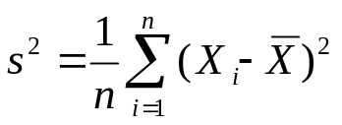
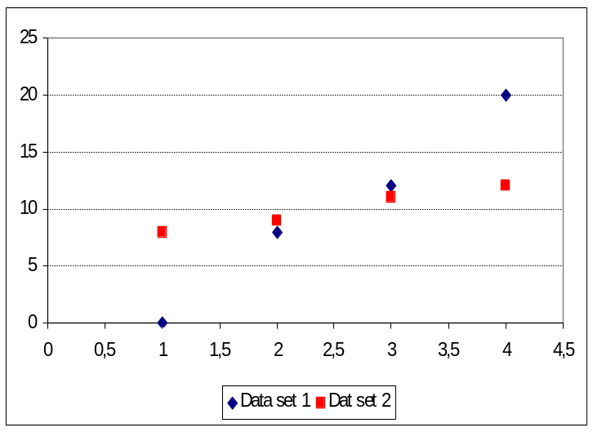
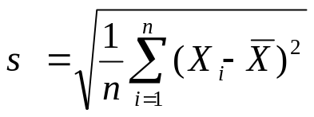
Statistical background (1/3)
Variance
  Measure of the spread of data in a data set
  Example:
    Data set 1 = [0, 8, 12, 20], Mean = 10, Variance = 52
    Data set 2 = [8, 9, 11, 12], Mean = 10, Variance = 2.5
Also version with (n-1)
Standard deviation
  Square root of the variance
  Example:
    Data set 1, Std. deviation = 7.21
    Data set 2, Std. deviation = 1.58
Also version with (n-1)

Slide 4
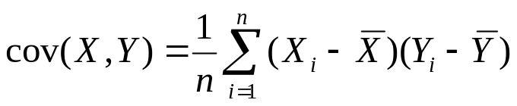
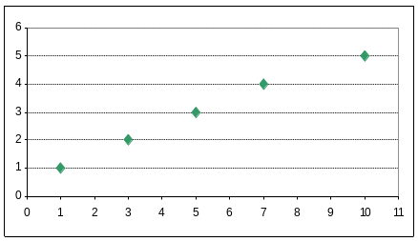
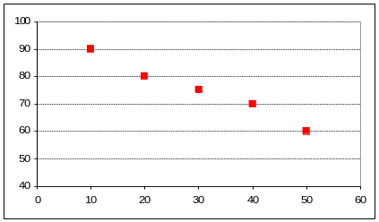
Statistical background (2/3)
Covariance
  Variance and standard deviation operate on 1 dimension, independently of the other dimensions
  Covariance: similar measure to find out how much the dimensions vary from the mean with respect to each other
  Covariance measured between 2 dimensions
  Covariance between X and Y dimensions:
Also version with (n-1)
  Result: value is not as important as its sign
  (+/− see examples below, 0 – two dimensions are independent of each other)
  Covariance between one dimension and itself: cov(X, X) = variance(X)
Student example, cov = +4.4
Sport example, cov = −140
The more study hours, the higer grading
The more training days, the lower weight
grading
weight
study hours
training days

Slide 5
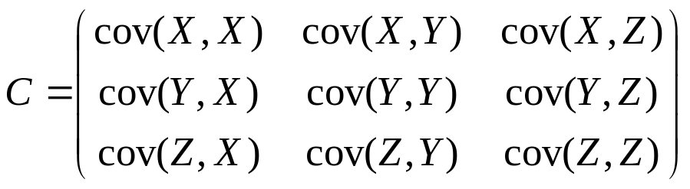
Statistical background (3/3)
Covariance matrix
  All possible covariance values between all the dimensions
  Matrix for X, Y, Z dimensions:
  Matrix properties
  1) Number of dimensions is n. Then the matrix is n x n.
  2) Down the main diagonal covariance value is between one of the dimensions and itself – variance of that dimension.
  3) cov(A, B) = cov(B, A), the matrix is symmetrical about the main diagonal.

Slide 6
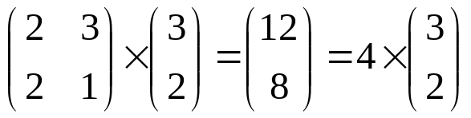
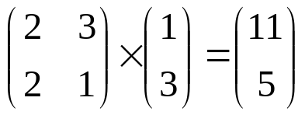
Matrix algebra background (1/2)
Eigenvectors and eigenvalues
  Example of eigenvector Example of non-eigenvector
eigenvector
eigenvalue associated with the eigenvector
  1st example: the resulting vector is an integer multiple of the original vector
  2nd example: the resulting vector is not an integer multiple of the original vector
  Eigenvector (3,2) represents an arrow pointing from the origin (0,0) to the point (3,2)
  The square matrix is the transformation matrix, resulting vector is transformed from its original position
  How to obtain the eigenvectors and eigenvalues easily
    Use some math library, for example Mathlab:
    [V, D] = eig(B); V: eigenvectors, D: eigenvalues, B: square matrix

Slide 7
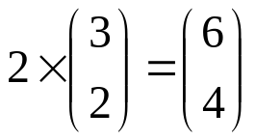
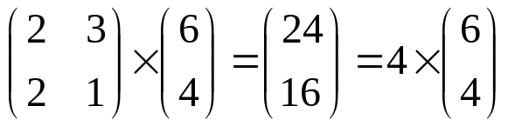


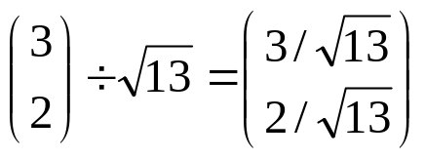
Matrix algebra background (2/2)
Eigenvectors properties:
  Can be found only for square matrices
  Not every square matrix has eigenvectors
  n x n matrix that does have eigenvectors, there are n of them
  Eigenvector scaled before the multiplication, the same multiple of it as a result
  All the eigenvectors of a matrix are perpendicular, ie. at right angles to each other, no matter how many dimensions there are
  Important because it means the data can be expressed in terms of the perpendicular eigenvectors, instead of expressing them in terms of the x and y axes
  Standard eigenvector – eigenvector whose length is 1
vector
vector length
standard vector

Slide 8
Using PCA in divisive clustering
Calculate the principal axis
  Choose the eigenvector with the highest eigenvalue of the covariance matrix.
Select the dividing point along the principal axis
  Try each vector as dividing and select the one with the lowest distortion.
Divide the vectors according to a hyperplane
Calculate the centroids of the two sub clusters

Slide 9
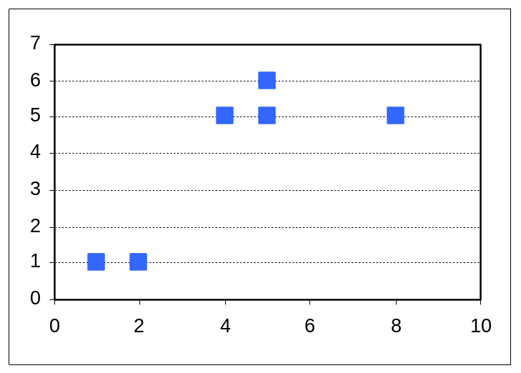
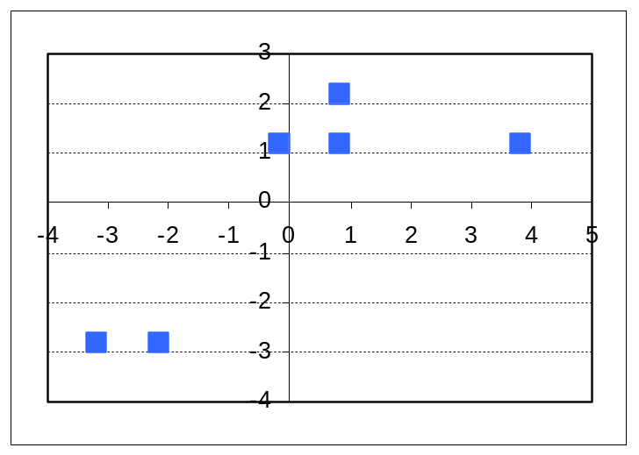
PCA Example (1/5)
Calculate Principal Component
Step 1.1: Get some Data
Step 1.2: Subtract the mean
  x = 4.17 y= 3.83
Point | X | Y | X – X | Y - Y
A | 1 | 1 | -3.17 | -2.83
B | 2 | 1 | -2.17 | -2.83
C | 4 | 5 | -0.17 | 1.17
D | 5 | 5 | 0.83 | 1.17
E | 5 | 6 | 0.83 | 2.17
F | 8 | 5 | 3.83 | 1.17

Slide 10
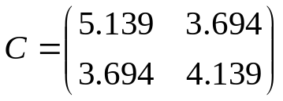
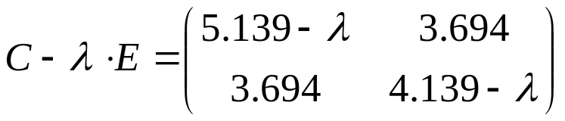
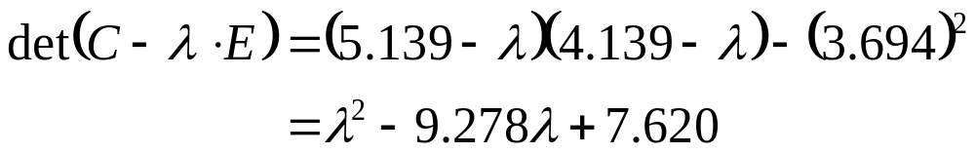
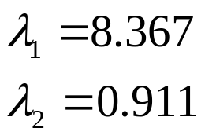

PCA Example (2/5)
Step 1.3: Covariance matrix calculation
Positive cov_{ij} values
→ x and y values increase together in dataset
Step 1.4: Eigenvectors and eigenvalues calculation –Principal axis
a) Calculate eigenvalues λ of matrix C
Where E is identity matrix
The characteristic polynom is the determinant. The roots of the function, that appears if you set the polynom equals zero, are the eigenvalues
Note: For bigger matrices (when original data has more than 3 dimensions), the calculation of eigenvalues gets harder. Choose for example POWER-method to solve. [4]

Slide 11
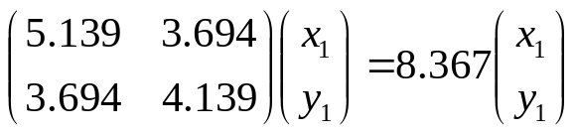

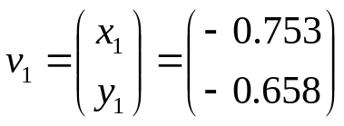
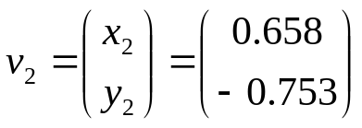
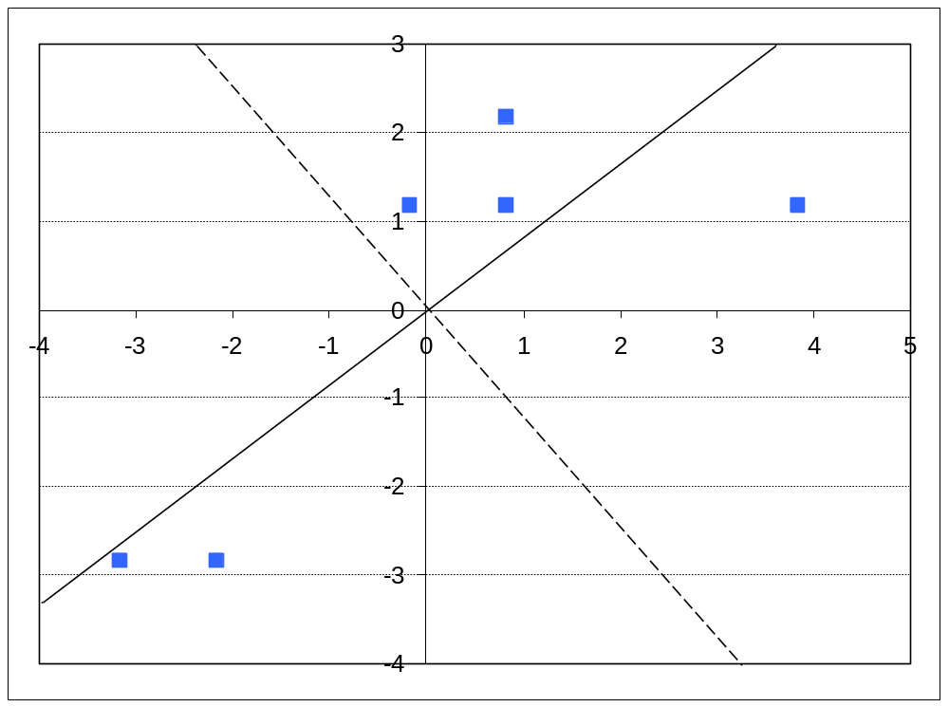
PCA Example (3/5)
b) Calculate eigenvectors v₁ and v₂ out of eigenvalues λ₁ and λ₂ via properties of eigenvectors (see matrix algebra background(3/3))
v₁
  Eigenvector v₁ with highest eigenvalue fits the best. This is our principal component
v₂

Slide 12
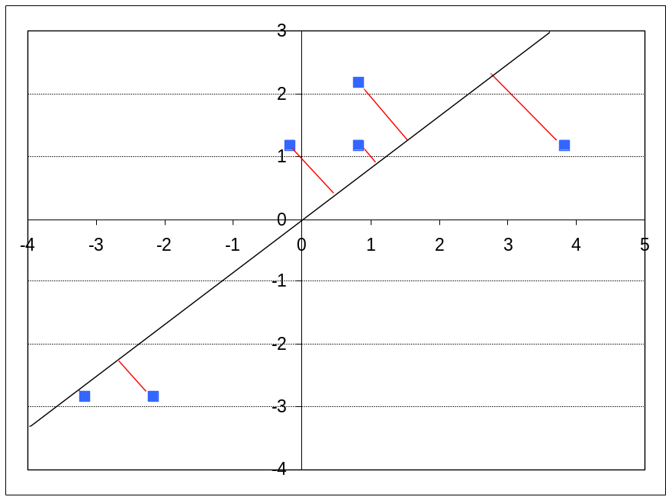
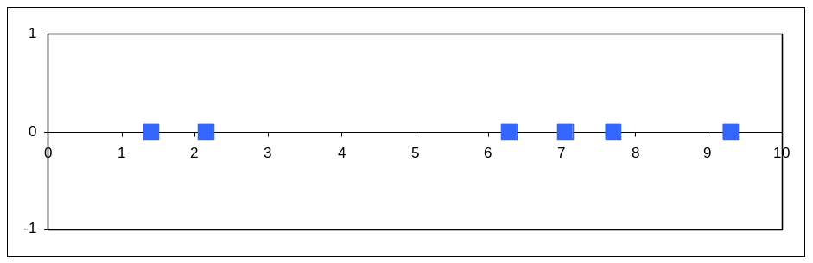
PCA Example (4/5)
2) Select the dividig point along the principal axis
Step 2.1: Calculate
projections on principal axis
2.2 Sort according to their projections

Slide 13
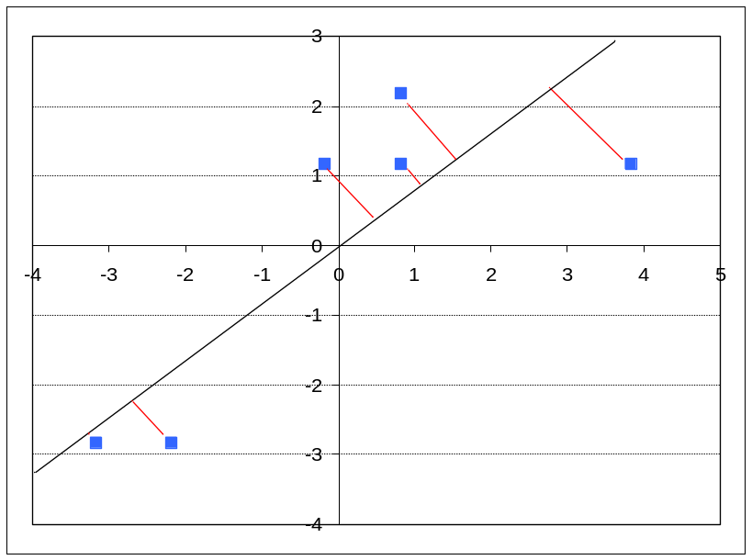

PCA Example (5/5)
Step 2.3: Try each vector as dividing point and calculate the distortion, choose the lowest
Dividing point A
Dividing point B
0.25
data point projection
D1 = 0.25
D2 = 2.44
D = D1 + D2 = 2.69
D1 = 5.11
D2 = 2.67
D = D1 + D2 = 7.78
centroid
hyperplane perpendicular to principal component
<
dividing point
Take A as dividing point.
clusters

Slide 14
References
[1] Smith I L.: A tutorial on Principal Components Analysis. Student tutorial. 2002.
http://csnet.otago.ac.nz/cosc453/student_tutorials/principal_components.pdf.
[2] http://de.wikipedia.org/wiki/Hauptkomponentenanalyse
[3] http://de.wikipedia.org/wiki/Eigenvektor
[4] R.L. Burden and J.D. Faires, Numerical Analysis (third edition). Prindle, Weber & Smith, Boston, 1985. (p. 457)

